Slide 1



Sustainable Supply Chain Performance Analysis Dashboard
Submitted By- Madhur Chaturvedi

Slide 2

Learning Objectives
Data Cleaning and Preparation
Data Modeling and Structuring
Adding Data in Power BI
Creating Dashboards in Power BI
Data Visualization Techniques
Chart Creation and Interpretation
Analyzing Supply Chain Performance
Optimizing Logistics and Transportation
Stock and Supplier Management
Decision-Making Based on Data Insights
GOAL
Source :
www.freepik.com/

Slide 3
Tools and Technology used
In this project, Power BI was used as the primary tool for data analysis and visualization. Power BI enabled efficient data cleaning, data modeling, and dashboard creation, allowing for interactive and insightful representations of supply chain performance. Various charts, graphs, and filters were utilized to analyze shipping costs, stock levels, supplier contributions, and transportation efficiency. By leveraging Power BI’s powerful visualization and data integration features, meaningful insights were derived to optimize logistics and business decision-making.

Slide 4
Methodology
Vertical Bar Chart – To compare stock levels across different product types.
Horizontal Bar Chart – To analyze the number of products sold on different routes.
Stacked Column Chart – To visualize product sales distribution.
Pie Chart – To show the percentage distribution of transportation modes.
Table Visualization – To display order quantities, suppliers, and stock levels.
Slicers – To filter data dynamically based on different parameters.

Slide 5
Problem Statement:
What is the average shipping cost for different transportation modes?
Which transportation mode has the longest average shipping time?
What is the average shipping cost for each product type?
Which product type has the highest average shipping time?
How do the average shipping costs compare across different routes?
Which supplier has the highest average stock level?
What is the relationship between average shipping cost and shipping time for different transportation modes?
Which product type has the lowest average shipping time?
How do average shipping times vary among different product types?
Which transportation mode has the highest average shipping cost and why might that be?

Slide 6
Solution:
Find the average shipping cost for each transportation mode by dragging shipping cost data to a chart and changing the aggregation to "Average."
Identify the transportation mode with the longest shipping time using a bar chart and setting the aggregation to "Average" for shipping time.
Find the average shipping cost for each product type by adding a chart and changing the shipping cost aggregation to "Average."
Compare shipping times for different product types using a horizontal bar chart with the shipping time set to "Average."
Analyze shipping costs for different routes using a stacked column chart and setting the aggregation to "Average" for cost.
Find the supplier with the highest stock levels using a vertical bar chart and sorting it to see the highest value.
Compare shipping cost and shipping time using a scatter plot with both values set to "Average."
Identify the product type with the shortest shipping time using a horizontal bar chart and sorting it in ascending order.
Compare average shipping times for different product types using a stacked column chart and changing the aggregation to "Average."
Find the transportation mode with the highest cost using a pie chart to compare cost percentages.

Slide 7
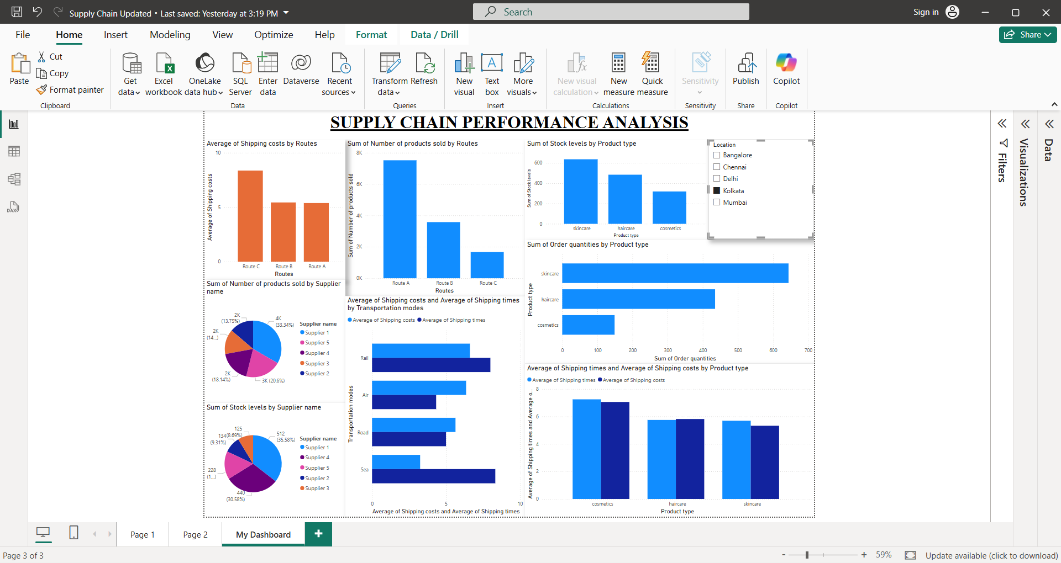
Screenshot of Output:

Slide 8
Conclusion:
This project helped analyze supply chain performance using Power BI. By creating charts, tables, and slicers, we identified key insights such as average shipping costs, shipping times, stock levels, and supplier performance. Different visualization techniques made it easy to compare transportation modes, product types, and routes.
The insights from this analysis can help businesses optimize shipping methods, reduce costs, and improve supply chain efficiency. Using Power BI’s features, we successfully turned raw data into meaningful information for better decision-making.

